Slide 1


SAFEGUARDING SOCIETY
WOMEN SAFETY
DIVA GUARD
Presented by
TEAM: 2023_IT_WAS

Slide 2
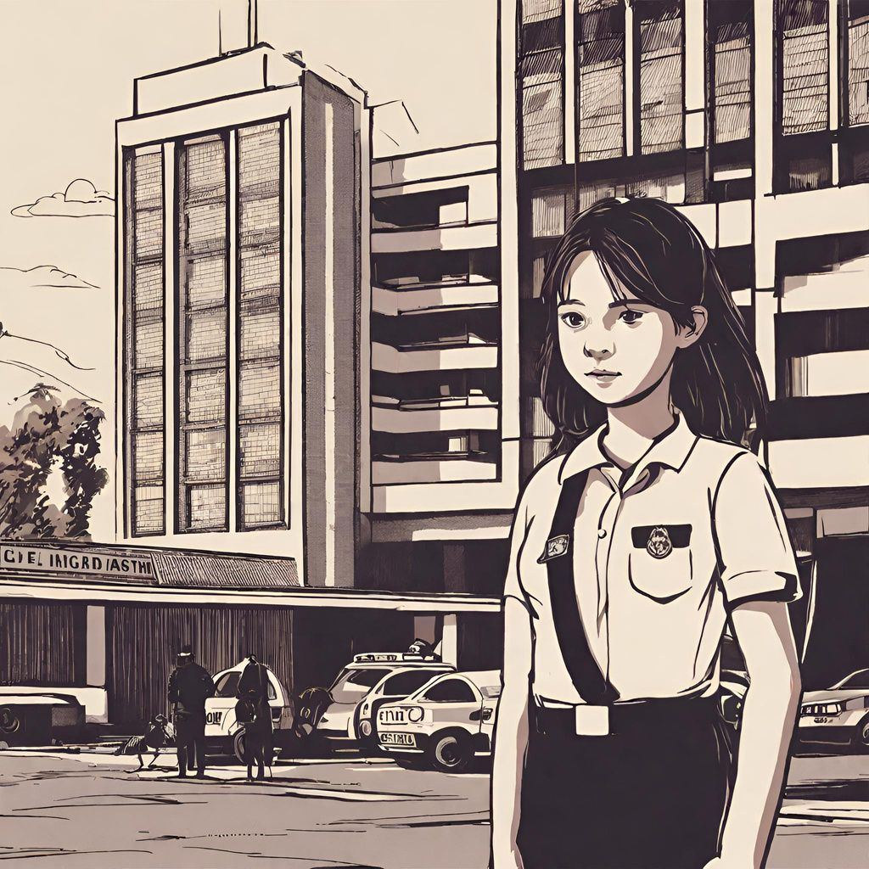





What we all face ??
ROUTE TO POLICE STATION??
SAFETY CONCERNS WHILE TRAVELLING
ROUTE TO POLICE STATION??
PHYSICAL SAFETY!!
HOSPITAL??
HOSPITAL??
BUS STOP??
SAFEST
ROUTE??
UNWANTED
EYES
NEAR BY SAFE PLACE??
ACCESS TO
EMERGENCY
SERVICES

Slide 3
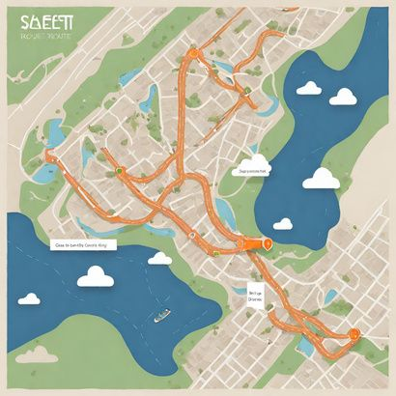

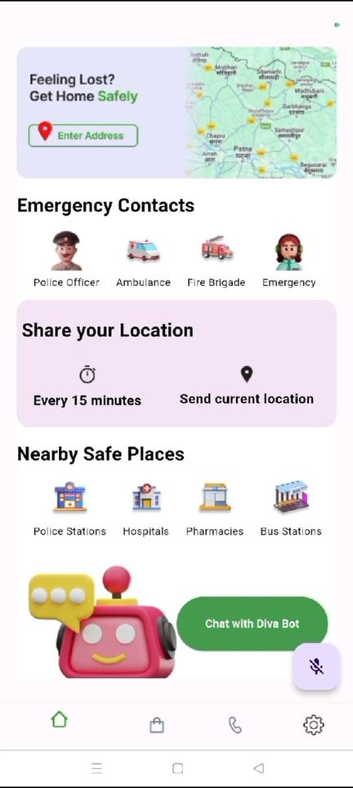






DIVA GUARD AS A SHIELD !!
DIVA GUARD
FIND SAFEST ROUTE
EMERGENCY HELPLINES
EMERGENCY HELPLINES
Provides you with the safest path to travel from your source location to destination .
Call Police , Ambulance , National Emergency Helpline
Call Police , Ambulance , National Emergency Helpline .
SHAKE YOUR PHONE , HIT UP YOUR CREW
NEARBY SAFE PLACES
Check all nearby police stations , hospitals , pharmacies , bus stops in an unknown location.
Provides you with the safest path to travel from your source location to destination .
DIVA BOT
FAKE CALL
A chatbot to help you and give you suggestions when nobody is there for help.
Get a call to pull yourself out of an uncomfortable situation.
VOICE ACTIVATION
Providing the differently abled people to easily access the features of the app by voice commands.
BUY SAFETY PRODUCTS
A website to allow women shop for products required for their safety.

Slide 4
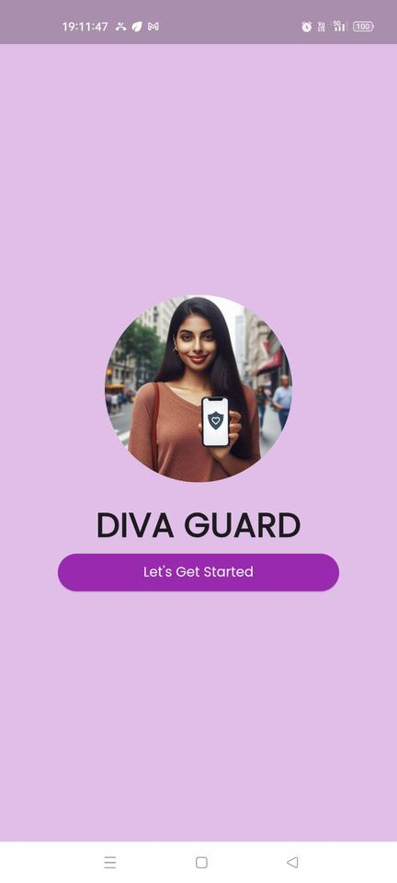
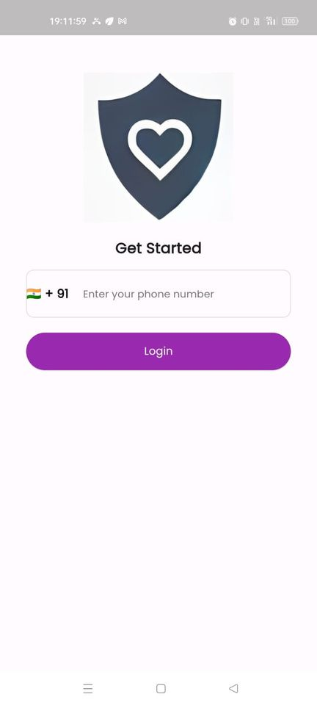
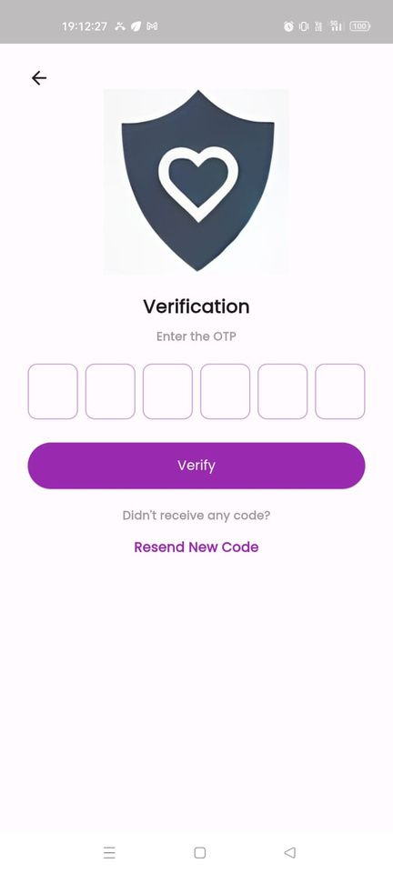
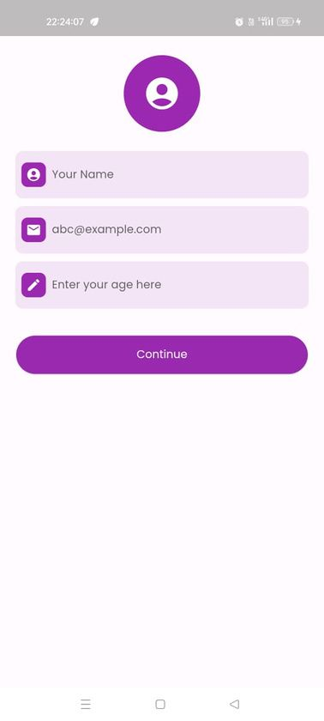
USER REGISTRATION AND LOGIN
DIVA GUARD

Slide 5

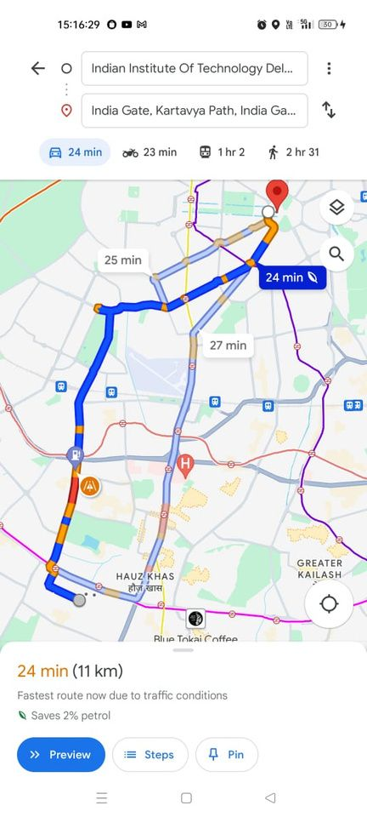
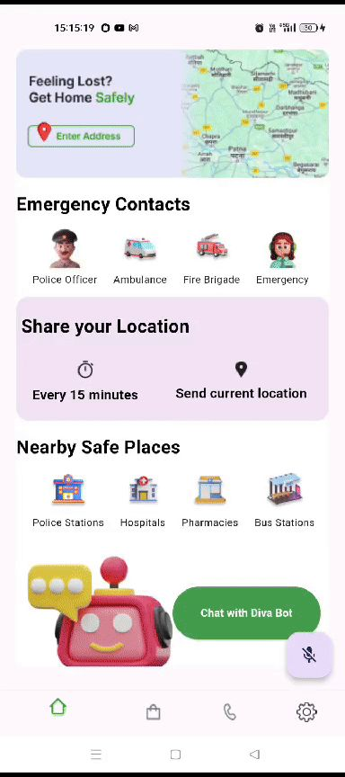








DIVA GUARD
SAFEST ROUTE
Web Scraping
1
Geocoding &
Crime categories
2
Assigning weights
3
Geocoding of police station to get their latitude and longitude using Mapquest API.
Use of model of sentence-transformers to identify crime categories reported in police stations.
Weights assigned to different categories of crime,
6 best routes were found between start destination and end destination based on risk factors.
Web scraping for crime data and police station location data.
Website used- Safecity
/routes endpoint
4
/safest_path endpoint
5
5
Input Data
6
High Level Design
/safest_path endpoint takes response from /routes and displays the safest path among the all 6 fetched previously , the one with lowest risk score.
User gives input data : Start_location and End_location .
This is sent to /safest_path endpoint which gives the safest path as output , in json format.
/routes endpoint when called from the base URL fetches the 6 best routes and returns it as a response .
Response on App UI
7
TECH STACKS USED
The {Lat,Lng} of different nodes obtained in the path is stored in an array and then passed upon to flutter_google_maps package which renders the markers and creates a polyline out of it.
Google maps Response
Diva Guard Response
Python
Sentence Transformers
Model
FastAPI
Geocoder
ngrok
Mapquest API
flutter_google_maps
Google maps API

Slide 6
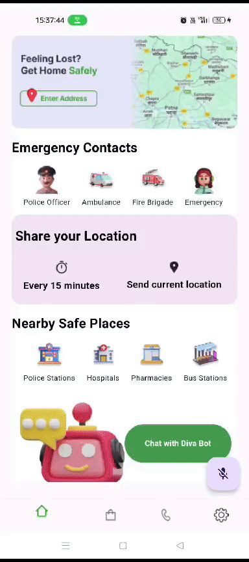



DIVA GUARD
ChatBot
What and How?
Why on WEB?
Give suggestions to user in case they need some help while they are in danger.
Chatbot is trained so as to give responses to a person in danger or needs your help.
Chatbot can be trained in future to give real-time responses based on user’s current location.
Chatbot in app will be highly memory and CPU intensive.
It will make the app unreasonably slow.
Scalability- The profit of displaying chatbot on the web so that any changes can be readily done. This won’t cause frequent app updates.
Tech Stack :
UI/UX
1
API Call
2
Make the API key for OpenAI. Then call the API from the app making it to answer to a person in danger and needs it’s help.
Develop the UI/UX of the website using React
React
Node.js
OpenAI API

Slide 7

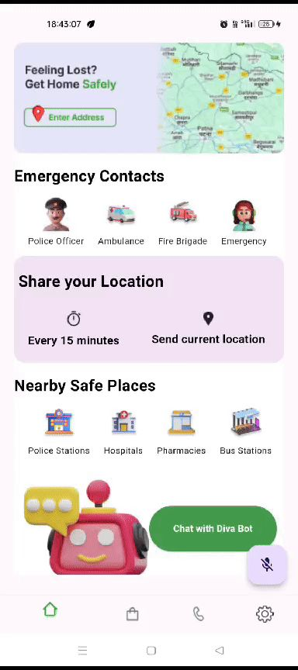

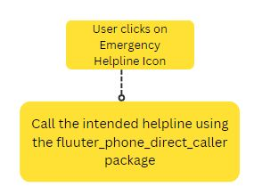
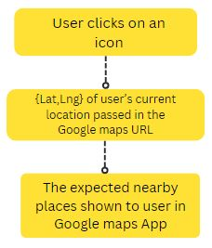
DIVA GUARD
Emergency Helpline & Nearby Safe Places
Emergency Helpline
Nearby Safe Places
A user friendly interface to enable user to give a call to Police , Ambulance and National Emergency by just one click.
Package used : flutter_phone_direct_caller
Gives user a very easy way to locate nearby police stations , hospitals , pharmacies , bus stops in case she is in an unfamiliar location
Redirects user to google maps with just one simple click.

Slide 8
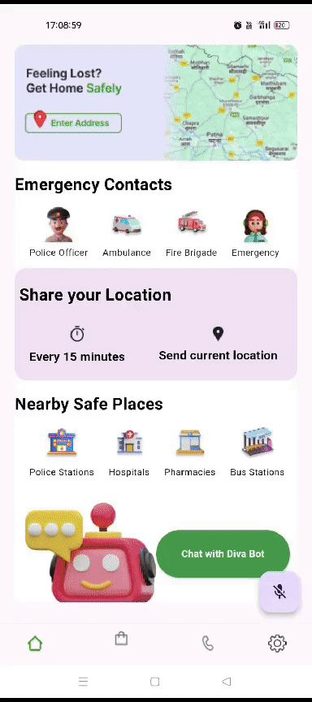
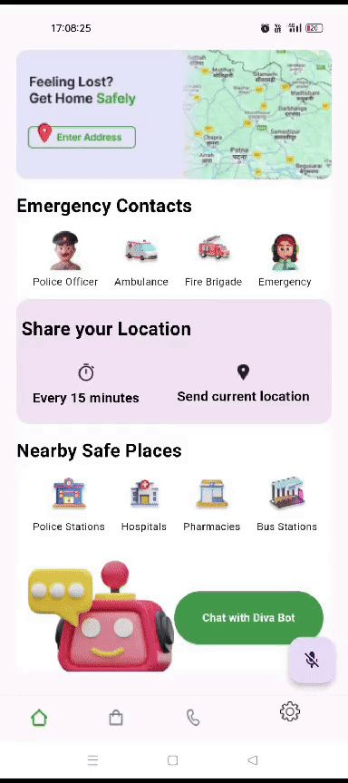
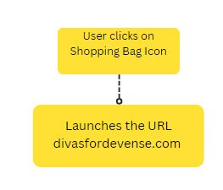
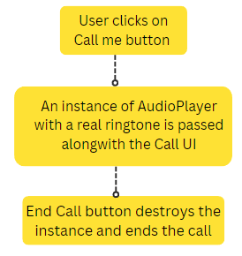
DIVA GUARD
Fake Call & Buy Safety Products
Fake Call
Buy Safety Products
Sometimes we need a call to get ourselves out of an uncomfortable situation
The Fake Call option provides user with a misleading 1nstagram UI,with the safely hidden Fake Call option to get a call for herself.
Here we have attached a URL link of a website where women can go and surf for different range of safety products like Fight Fobs , Self Defense Kits , pepper gel etc.

Slide 9


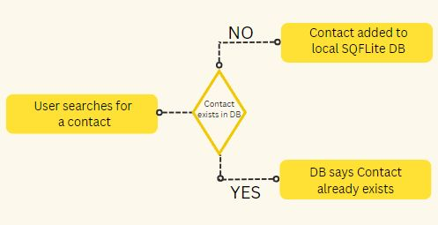
Location Sharing to Emergency Contacts
DIVA GUARD
Location Sharing
Through phone shake
Through button clicking
Add Emergency Contacts
Stored in SQFlite
Advantage of App not storing user’s contact data
Easy addition , deletion of contacts and a quick call option

Slide 10
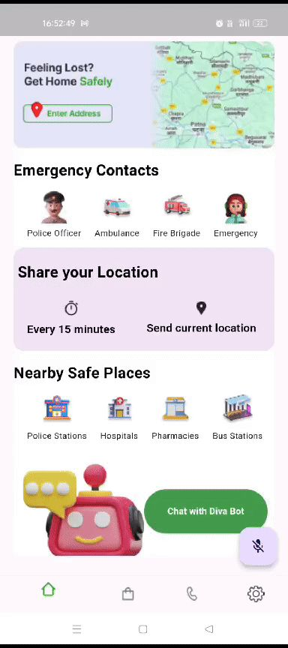
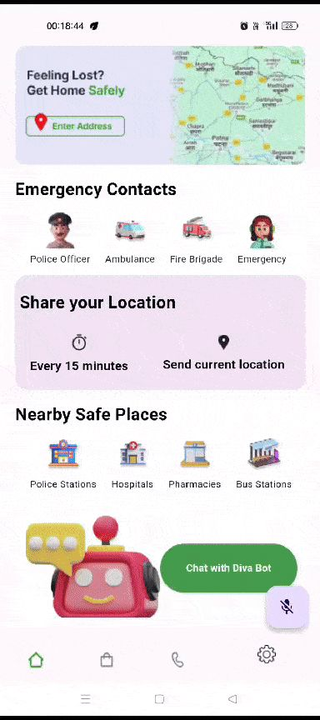

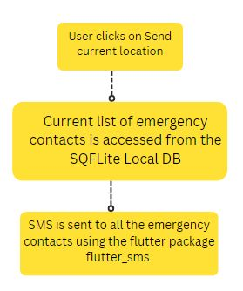
DIVA GUARD
Location Sharing to Emergency Contacts
SMS Location sharing
Safe Shake- What and How?
User has 2 options, to send SMS one time or to send in a timely manner.
Just clicking on ‘Send Current Location’ will share location of user to all emergency contact one time.
Just clicking on ‘Every 15 minutes’ , this will send total 16 messages (limit can be changed), so will be activated for 4 hours.
User shakes phone 5 times for the first message to be sent and then 1 message for every shake further until the reset timer is hit.
The specific gravity of shake should be at least 7 and reset timer is 3 secs.
SMS will contain the current location of user.

Slide 11
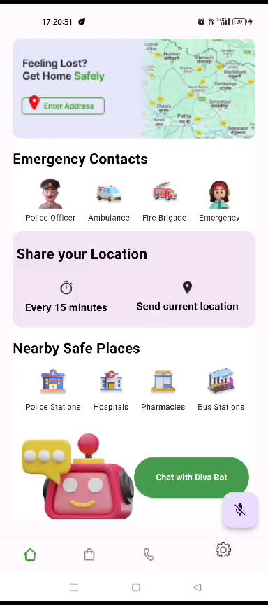
DIVA GUARD
Voice Activation
UI/UX
1
Voice Activated Features
An additional feature added , keeping in mind Differently Abled people.
A real quick alternative for users to access the features of the app
Users can access the prominent features of the app by using voice commands like Call Police , Fake call , Send SMS , Open Chatbot , find police stations near me etc.
User will have to click the mic button before speaking
Speech to text
2
Use of flutter_speech_to_text to convert the user voice into text stored by the app.
App Functioning
3
The app will look for keywords in the stored text and call the required function.

Slide 12

DIVA GUARD
Contributions of the Members
TEAM: 2023_IT_WAS
Kashish
Harshita Jha
Kriti Thawaria
User Registration and Firebase Authentication
Addition & deletion of emergency contacts
Web Scrapping for crime data and police data collection
Geocoding of Police Stations
Algorithm designing for Safest path feature
Nearby Safe Places feature
Buy Safety Products Feature
Chatbot Development
Frontend designing of the app
Emergency Helplines Feature
Location sharing through phone shake and button click feature
Fake Call Feature
Safest Route Feature integration into the app
UI designing
Backend implementation of the chatbot
Deployment and integration of the chatbot into the app

Slide 13
Future Improvements
DIVA GUARD
Safest Route
Upgrading the dataset to cover more diverse areas
Taking into account the traffic factor too
Automatic identification of user’s current location as their start location
Upgrading the crime dataset on regular basis.
Chatbot
Allowing the chatbot to automatically access different features of the app while providing suggestions to the user like accessing user’s current location to suggest them nearby hospitals etc. on its own.
Voice Activation
Allowing the voice activation to be activated on more commands and should work for various languages.
Fake Call
Upgrade the fake call feature so that the user engages in a real conversation with a bot.
Buy Safety Products
We can develop our own platform for the users to buy these products.

Slide 14

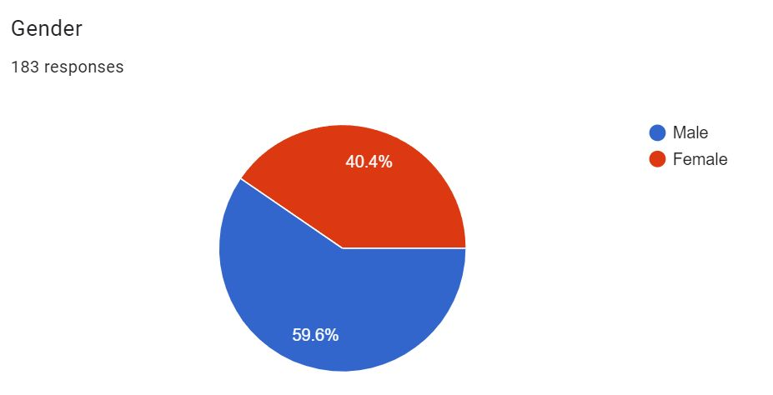
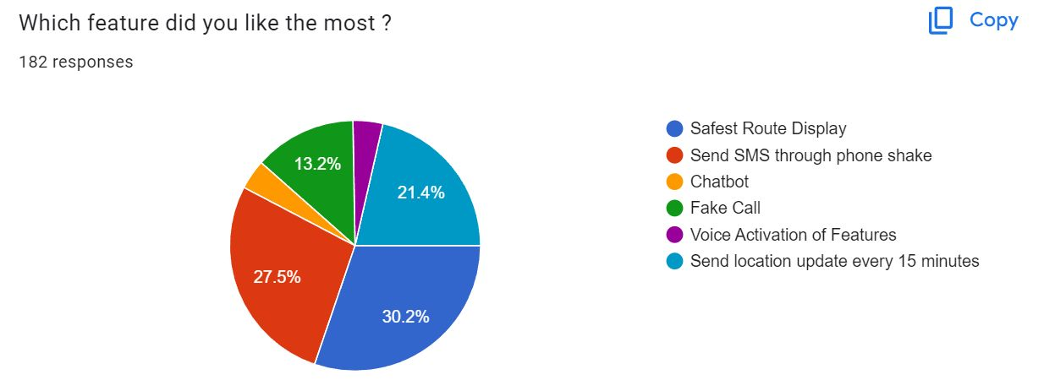
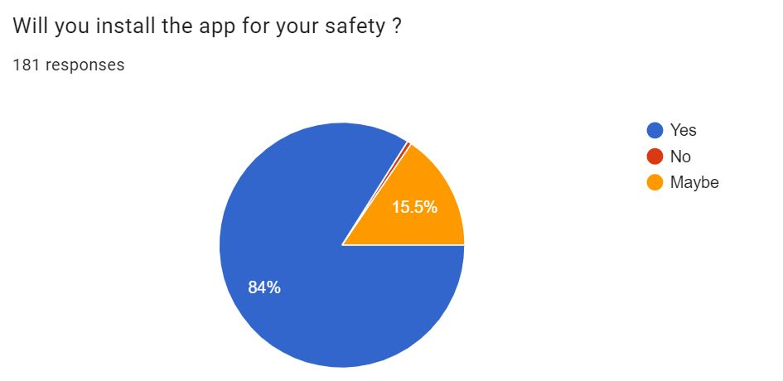
PUBLIC RESPONSE
The Safety app contains all the features one requires in the time of trouble. I liked the feature that one is instantly able to send the person's location to the emergency contact by just merely shaking it. I would surely like to have such an app installed in my phone.
This is a brilliant app for women safety, has given solution to almost all our concerns!!
This is truly helpful especially for the girls, women and old people to help them when they are in need.
Your safety app is great for helping people stay safe. It's easy to use and has helpful features .Keep up the good work seniors!!
"Great safety app! It provides peace of mind knowing that I have a reliable tool to keep me and my loved ones safe. Highly recommend!"
A great initiative. This is what we expect from students of an IIT. I suggest you should pitch this to the government so as to implement it on a wider scale.
Just watched the preview of your Hackathon project – amazing work! Your innovative approach, technical finesse, and problem-solving skills shine through. The presentation was top-notch too. Best of luck in the finale – I'm sure your project will leave a lasting impression!
Nice app, I do think that you should have some feature so that the phone shake doesn't send message accidentally, otherwise great app and it will surely be helpful to the society !!
Multiple options to be safe in one app is the best part.
Great idea and great implementation. This would surely reduce crime in the country. Also the UI/UX is pretty good. I would recommend everyone to download it!
The shake feature is quite innovative and unique in itself. I liked the overall idea of the App as a safety weapon.⭐
It is a great app. Eagerly waiting for it to be in play store. Being a college student, I cannot express that how helpful this app will be in my day to day life.
And finally, All the best guys for hackathon. Hoping to see you win ❤❤.
Idea is very good & innovative and it will definitely be helpful to everyone especially for child and woman security
Great initiative, this will surely be of great use for people concerning their safety.
DIVA GUARD

Slide 15
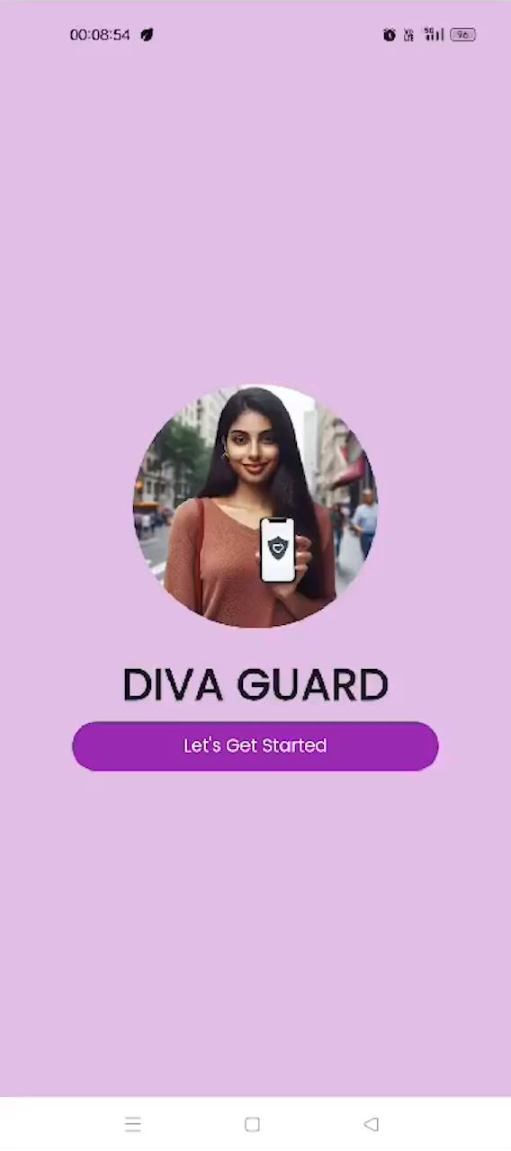
DEMO VIDEO
DIVA GUARD
Github Repo Link : https://github.com/kashish-10/Diva_Guard_2023_it_was

